Slide 1
CND111: Introduction to Digital Design
Getting Started in Verilog – Part 5

Slide 2
Parameters
Verilog constructs that allow a module to be used with different specification.
New parameter values can be passed in during module instantiation.
Parameters are basically constants hence it’s illegal to modify their values during runtime.
It’s illegal to declare a name that is already used by a net, variable or another parameter.

Slide 3
Parameters
You may declare the parameters as shown below
. Parameters can be overridden with new values during module instantiation.
module my_design
# ( parameter DATA_WIDTH=32;
parameter BUS_WIDTH=64; )
( input [BUS_WIDTH -1] addr ;
// other ports declaration )
module tb;
my_design # ( parameter DATA_WIDTH=32 , parameter BUS_WIDTH=64; ) d0 ([port_list]);
( input [BUS_WIDTH -1] addr ;
// other ports declaration )

Slide 4
Local Parameters
Verilog HDL local parameters are identical to parameters except that they cannot directly be modified by module instance parameter value assignments.
Ex: Encoding of states in FSM as local parameters.
localparam state0 = 3'b000,
state1 = 3'b001,
state2 = 3'b010,
state3 = 3'b011,
state4 = 3'b100;

Slide 5
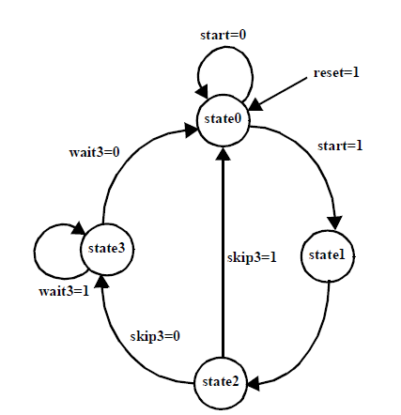
Finite State Machine: example
1
Module inputs, outputs, and state definition:
module my_fsm (clk, rst, start, skip3, wait3, Zout);
input clk, rst, start, skip3, wait3;
output reg [2:0] Zout; // Zout is declared reg so that it //can be assigned in an always block.
parameter state0=0, state1=1, state2=2, state3=3;
reg [1:0] cur_st, nxt_st;
in state0: Zout = 000,
in state1: Zout = 101,
in state2: Zout = 111,
in state3: Zout = 001.

Slide 6
Finite State Machine: example
2
always @ (cur_state or start or skip3 or wait3)
begin : current_state_logic //Name of always procedure.
case (cur_state)
state0: begin
if (start) nxt_st = state1;
else nxt_st = state0;
end
state1: begin
nxt_st = state2;
end
state2: begin
if (skip3) nxt_st = state0;
else nxt_st = state3;
end
state3: begin
if (wait3) nxt_st = state3;
else nxt_st = state0;
end
default: nxt_st = state0;
endcase
end
Combinational current state logic:
in state0: Zout = 000,
in state1: Zout = 101,
in state2: Zout = 111,
in state3: Zout = 001.

Slide 7
Finite State Machine: example
3
Sequential next state logic:
always @(posedge clk or posedge rst)
begin : next_state_logic
if (rst) cur_state = state0;
else cur_state = nxt_st;
end
in state0: Zout = 000,
in state1: Zout = 101,
in state2: Zout = 111,
in state3: Zout = 001.

Slide 8
Finite State Machine: example
4
Output logic:
always @(state) begin : output_logic
case (cur_state)
state0: Zout = 3’b000;
state1: Zout = 3’b101;
state2: Zout = 3’b111;
state3: Zout = 3’b001;
default: Zout = 3’b000; // default avoids latches
endcase
end
endmodule
in state0: Zout = 000,
in state1: Zout = 101,
in state2: Zout = 111,
in state3: Zout = 001.

Slide 9
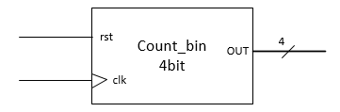
Counters: Binary Counter
Counters are a simple type of FSM where the separation of the flip-flop generation code is usually not worth the effort.
Binary Counter: An n-bit binary counter can be constructed with n flip-flops, and it usually has a single-cycle state diagram.
module countbin (clk,rstn,count); input clk, rstn; output reg [3:0] count; always @ (posedge clk or negedge rstn) begin if (!rstn) count <= 4'b0; else count <= count + 1; end endmodule

Slide 10
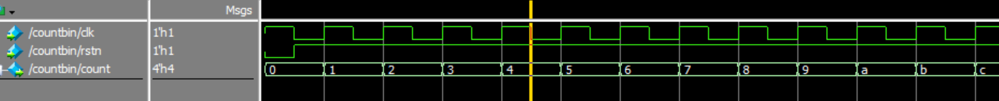
Counters: Binary Counter
module countbin (clk,rstn,count); input clk, rstn; output reg [3:0] count; always @ (posedge clk or negedge rstn) begin if (!rstn) count <= 4'b0; else count <= count + 1; end endmodule

Slide 11
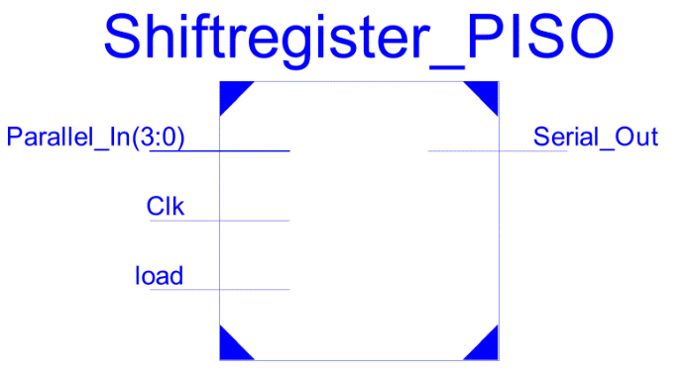
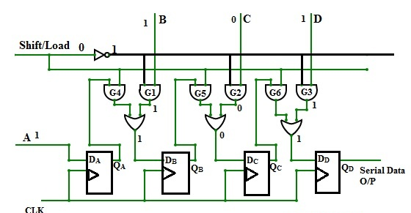
PISO (Parallel In Serial Out)
The shift register which uses parallel input and generates serial output is known as the parallel input serial output shift register or PISO shift register.
This shift register works in a reverse way to the SIPO shift register. In this type of shift register, the input data enters a parallel way and comes out serially.

Slide 12
Reading Memories from file
Two-dimensional arrays can be declared and accessed by word.
To get a bit(s), you must equate the output to a register or wire and select the bits from this new variable.
The data file consists of addresses and data.
The command $readmemb/$readmemh will read a file of binary/hex numbers into the array.
reg [wordsize:0] array [0:arraysize]
readmemb(“file_name”, array_name);
readmemb(“file_name”, array_name,
start_addr, finish_addrs);
readmemh(“file_name”, array_name);
// start_addr and finish addr are optional

Slide 13
Read Only Memory (ROM)
A read-only memory (ROM) is an array of inputs and b outputs. (size = 2^n x b)
The inputs are called address inputs while the outputs are called data outputs.
The contents of the ROM must be initialized.
Small ROMs can be initialized using a case statement.
input [2:0] rom_addr; //8 x 8 bit ROM
output reg [7:0] rom_dout;
always @(*)
case (rom_addr)
3’d0: rom_dout <= 8’b10101010;
3’d1: rom_dout <= 8’b11111000;
3’d2: rom_dout <= 8’b00100000;
3’d3: rom_dout <= 8’b11100011;
3’d4: rom_dout <= 8’b00000000;
3’d5: rom_dout <= 8’b00101110;
3’d6: rom_dout <= 8’b10111011;
3’d7: rom_dout <= 8’b11111011;
endcase

Slide 14
ROM Example 1
In this example, the code basically reads in a file called rom_data_hex.txt
The size of the memory is 2^address × data.
In Verilog this is represented by an array variable
input [4:0] rd_addr; //Read address
output [7:0] dout //Output data
reg [7:0] mem [31:0]; //word_size x array_size
//Initializing the ROM contents
Initial begin
$readmemh(”rom_data_hex.txt”, mem, 0, 31);
end
//Read port (asynchronous)
assign dout = mem[rd_addr];

Slide 15
ROM Example 2
2k x 12 bit ROM with 2 read ports
input [10:0] rd_addr1; //Address for the 1st read port
input [10:0] rd_addr2; //Address for the 2nd read port
output reg [11:0] dout1; //Output data1
output reg [11:0] dout2; //Output data2
reg [11:0] mem [2047:0];
//Initializing the ROM contents
initial
$readmemh(”rom_data_hex.txt”, mem, 0, 2047);
//Read ports (synchronous)
always @(posedge clk)
begin
dout1 <= mem[rd_addr1];
dout2 <= mem[rd_addr2];
end

Slide 16
Random Access Memory (RAM)
2k x 12 bit RAM
RAM in Verilog is also an array variable.
RAM has data input/output and a dedicated input address for each.
RAM has a control signal W_en to specify a write/read operation.
input [10:0] wr_addr; //Address for write port
input [10:0] rd_addr; //Address for read port
input [11:0] din; //Input data
Input write_en; //Write enable signal
output [11:0] dout; //Output data
reg [11:0] mem [2047:0];
//Initializing the RAM contents initial $readmemh(”mem_data_hex.txt”, mem, 0, 2047);
//Write and read ports (synchronous)
always @(posedge clk) begin
if (write_en)
mem[wr_addr] <= din;
else
dout <= mem[rd_addr];
end

